Slide 1
User Manual Dynamic Mathematics Principles
Team: Andres Cubas, Ingrid Troche
Mentor: Mario Eraso

Slide 2
Overview
You can use the application for educational purposes
This manual delivers an overview of the sample application. Beginning with the following information
Create Account
Select Activity
Select Fun-facts
Select History page

Slide 3
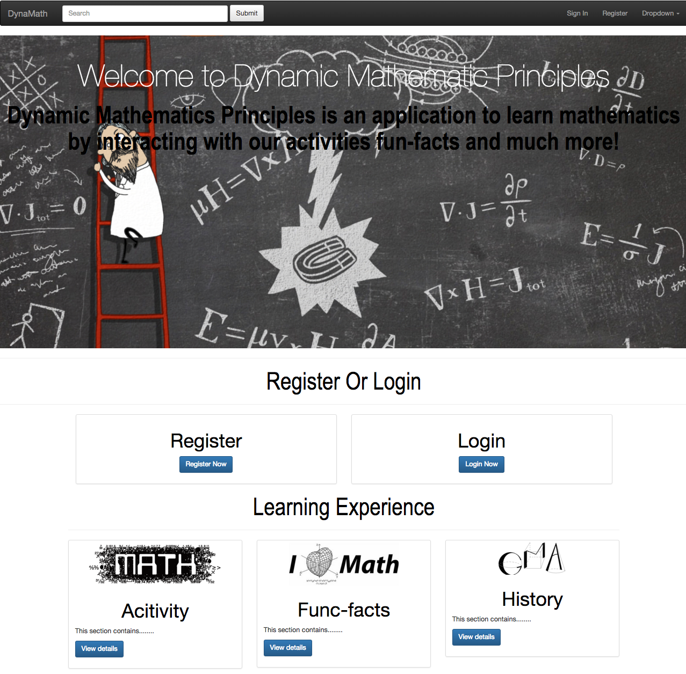
Step 1
User can click on register
User can click on activity page, fun-fact page, and history page to try out our activates

